Slide 1
WALT: Explain and provide an example of urban renewal.

Slide 2
Guiding Question: How does urban infrastructure change over time?

Slide 3
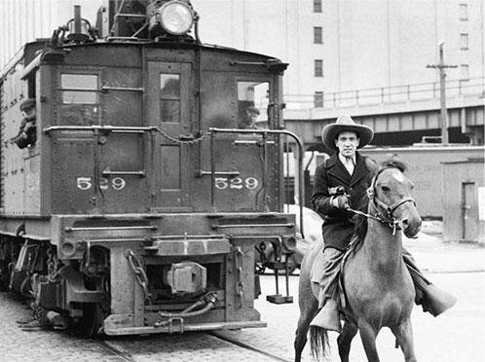
In 1847, New York City needed a rail line to ship freight. These rail lines were built at street level.

Slide 4
Freight trains in the roads were too dangerous, so the city elevated the trains.

Slide 5
Can you think of another city with an elevated train track?

Slide 6
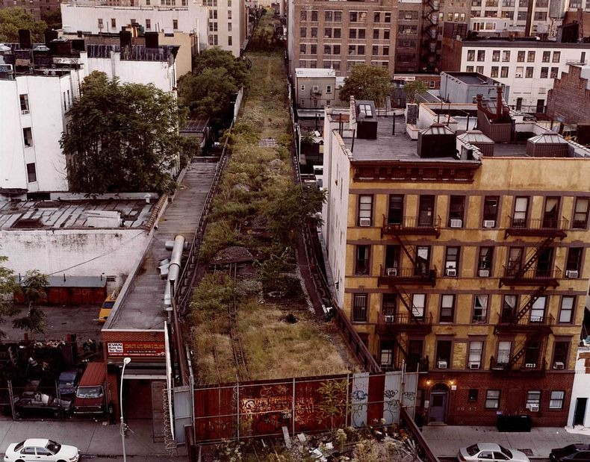
Over time, companies began to use trucks to move freight. The train tracks were eventually abandoned.

Slide 7
The abandoned tracks became overgrown with weeds. If this were your city, what would you do?

