Slide 1
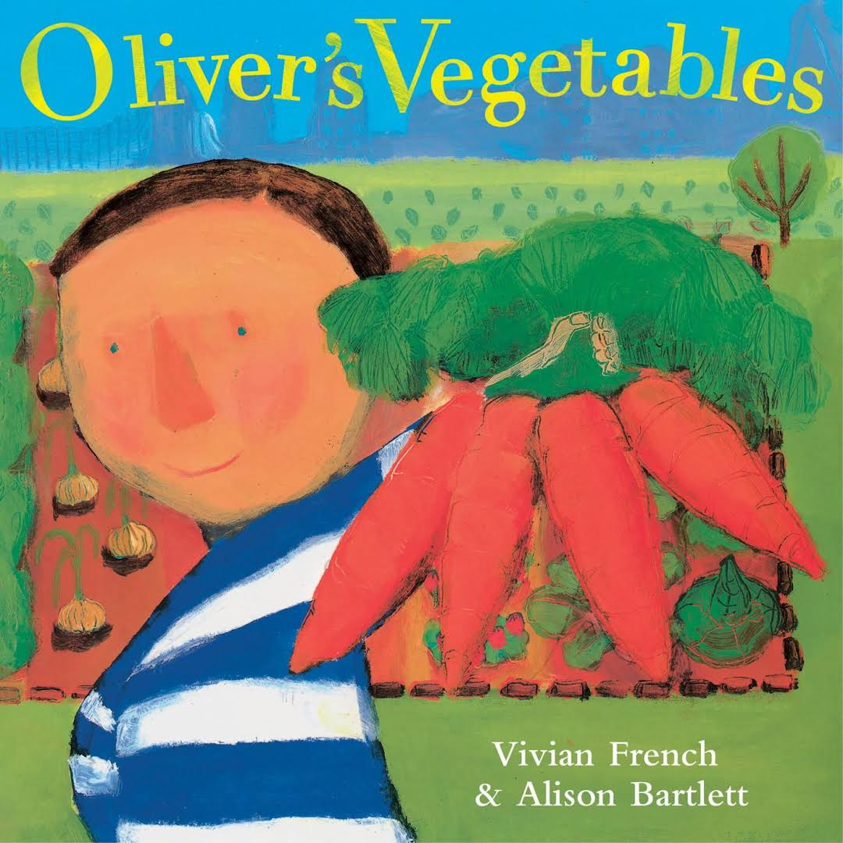
WALT: Form Questions . . .
with Oliver’s Vegetables, by Vivian French
and 1CV, GEMS World Academy, November 2016

Slide 2
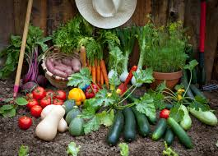
“The best thing about Grandpa’s house was the wonderful garden.”
How long does it take to walk to Grandpa’s house?
What grows in Grandpa’s garden?
How big is Grandpa’s garden?
How long did it take to grow the vegetables?
Where is Grandpa?
How does Grandpa grow his vegetables?
When did plant the vegetables?
Where did he get the seeds?
Who grows the plants?
How do the vegetables grow in different temperatures?

Slide 3
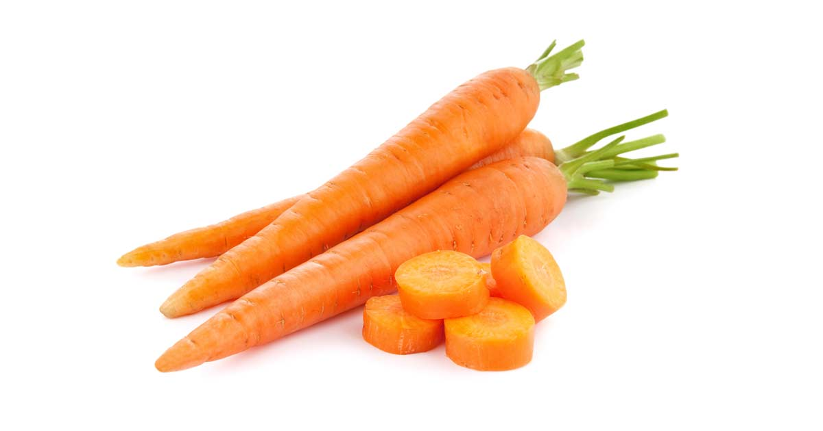
On Monday Oliver ate his first carrots.
When do carrots grow?
How did he find the carrots?
How did the carrots taste?
Where in the garden are the carrots growing?
How do the carrots look?
Why doesn’t Oliver eat his vegetables?
Where are the potatoes?
When can you pick the carrots?
Why is the dog pulling on the carrot?
Who owns the dog?
Why do carrots grow underground.

Slide 4
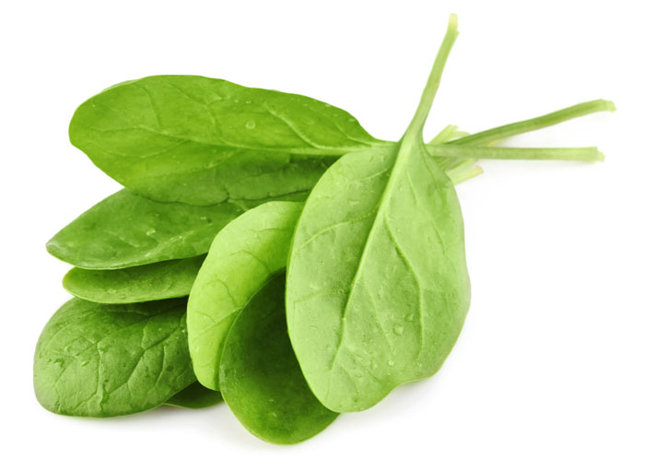
On Tuesday Oliver ate spinach for supper.
How does spinach taste?
Why doesn’t Oliver know more about gardens?
Who cooked the spinach and how?
Why is the dog hiding behind the spinach?
Where in the garden did Oliver find the leaves?
How big are spinach leaves?
How long did it take to pull out the leaves?
Why is spinach so green?
Why did he think spinach was a potato?
How did he feel after he ate the spinach?

Slide 5
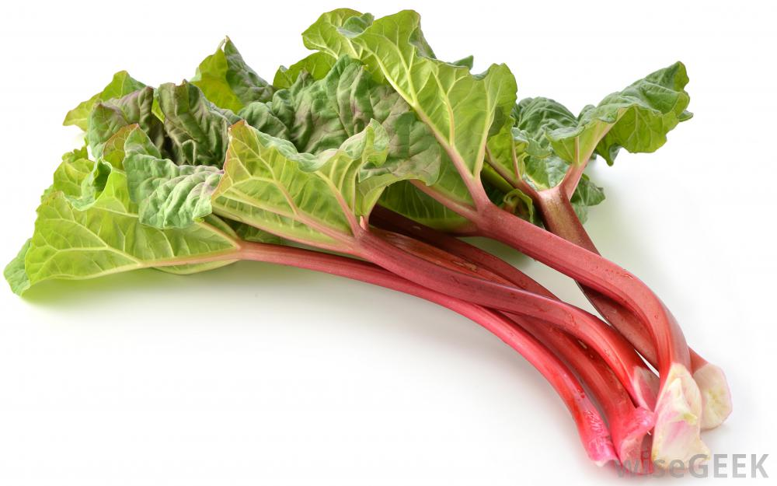
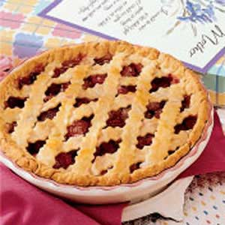
On Wednesday Oliver ate rhubarb pie.
Why are rhubarb stalks purple?
Why is the dog hiding?
Why is the boy pulling on the red stalk?
Where is rhubarb in the garden?
How can you make a pie?
Why does rhubarb look like a tree?
Why did Oliver think rhubarb was a potato?
What is rhubarb?
What does rhubarb taste like?
What size is rhubarb?

Slide 6
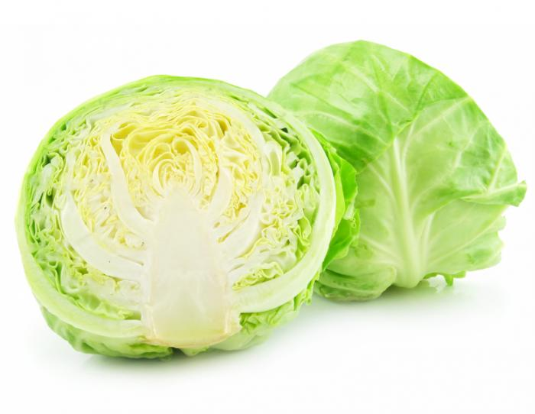
On Thursday Oliver had two helpings of cabbage.
Where did he find the snails?
What did the cabbage taste like?
How did he find the cabbage?
How big is the cabbage?
How does it feel?
Why does the cabbage look like a ball?
Why does cabbage have leaves?
Why does the inside of cabbage look like white chocolate?
Why isn’t it very green?
Why did he pick up the snails?

Slide 7
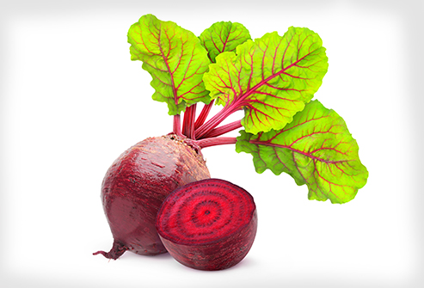
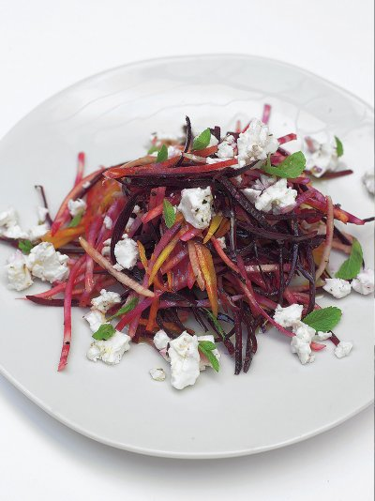
On Friday Oliver ate all of his beetroot salad.
Where do the beets grow?
What do beets taste like?
Is this bumpy or smooth?
Why are beets red?
Why is there red in the leaves?

Slide 8
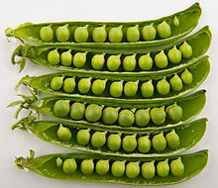
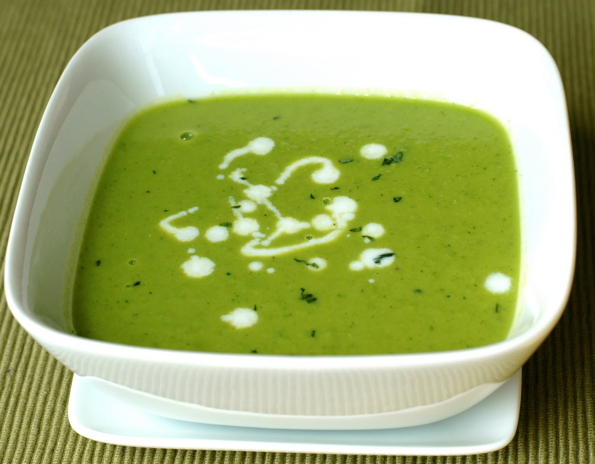
On Saturday Oliver had three helpings of pea soup. It was delicious!
How do peas taste?
How does pea soup taste?
Where in the garden do the peas grow?
Why are peas green?
Why is there white in the soup? How did they make the soup?
Why are peas small?

Slide 9
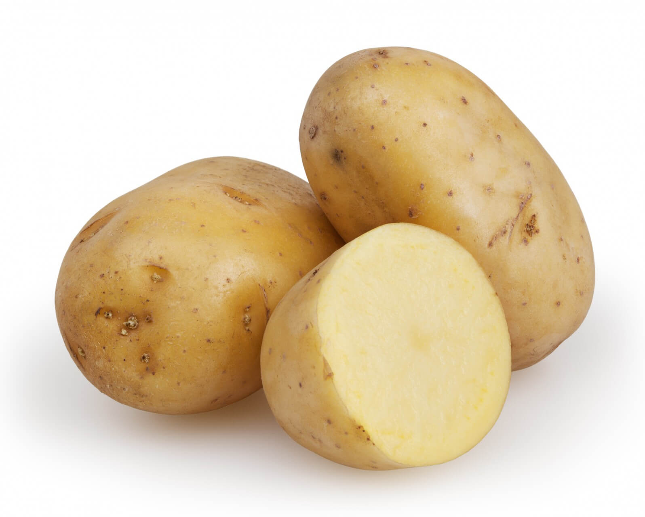
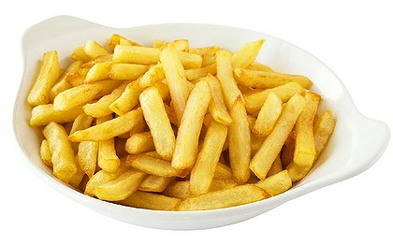
On Sunday Oliver found the potatoes and asked, “Can we have chips now?”
How do you make chips out of potatoes?
Why are chips not healthy for you even though they’re made out of potatoes?
Where did the potatoes grow?
What are chips made of?
Why do people put salt on their chips?
Why did it take so long for him to find the potatoes?
How long did it take to peel the potatoes?
How did he find the potatoes?

