Slide 1
A Camping Spree with Mr. Magee
By Chris Van Dusen
and the students of (Fill in the Blank):
“Tuning In” to Basic Forces and Simple Machines

Slide 2
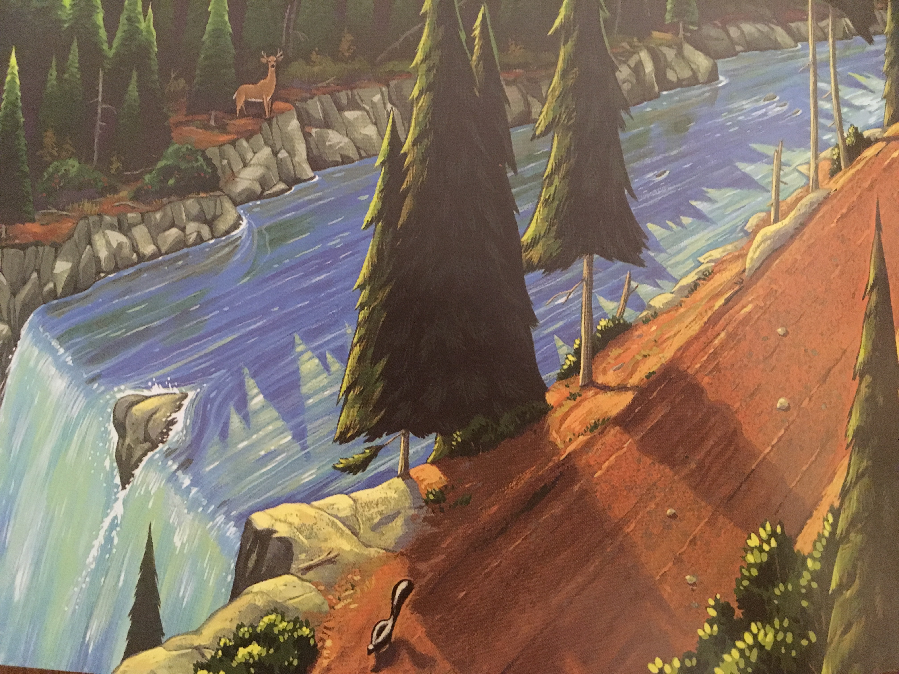
Erase these and insert your own class notes.
1. Gravity (water falling over the edge of the waterfall.)
Taken from A Camping Spree With Mr. Magee by Chris Van Dusen.

Slide 3
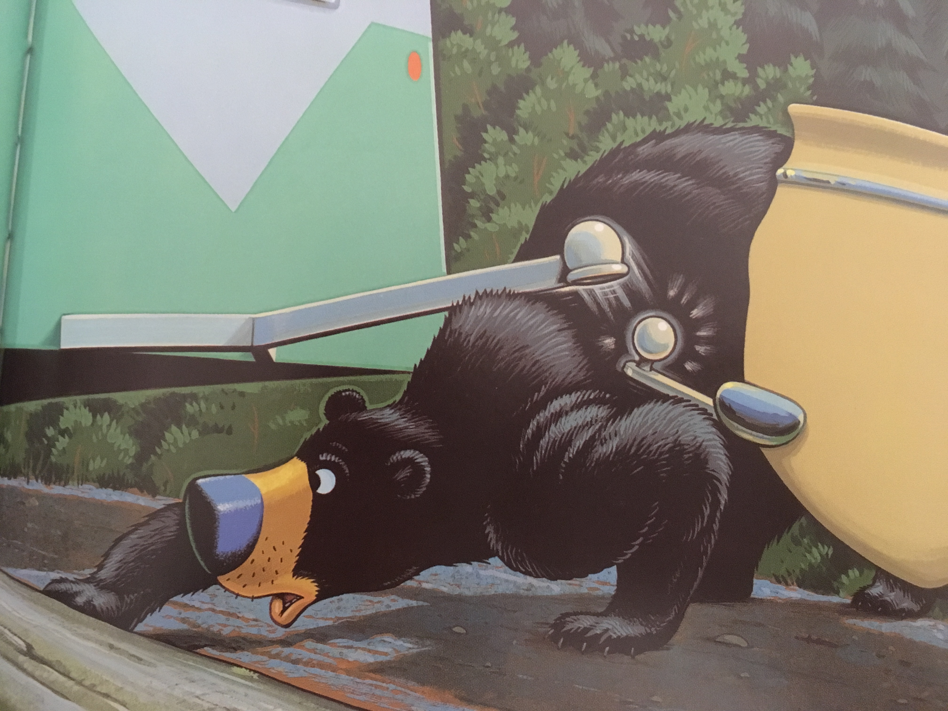
1. Push (bear pushes up hitch.)
Taken from A Camping Spree With Mr. Magee by Chris Van Dusen.

Slide 4
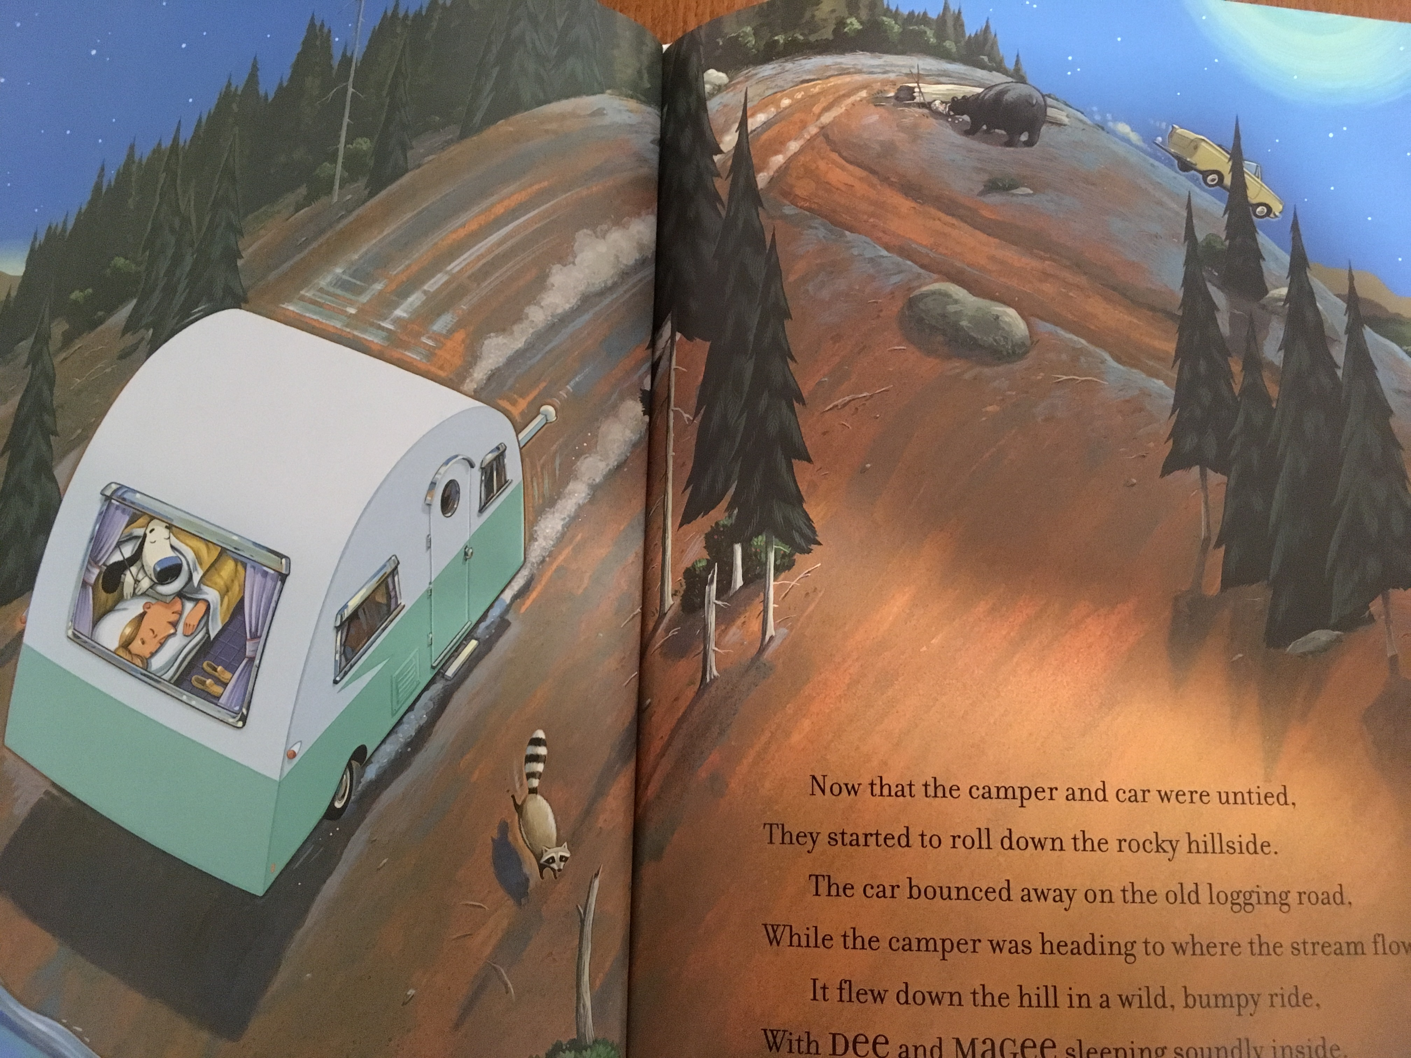
1. Wheels (enable car and camper to roll.)
2. Gravity (pulling car and camper towards down the hill.)
3. Ramp or inclined plane (hill).
Taken from A Camping Spree With Mr. Magee by Chris Van Dusen.

Slide 5
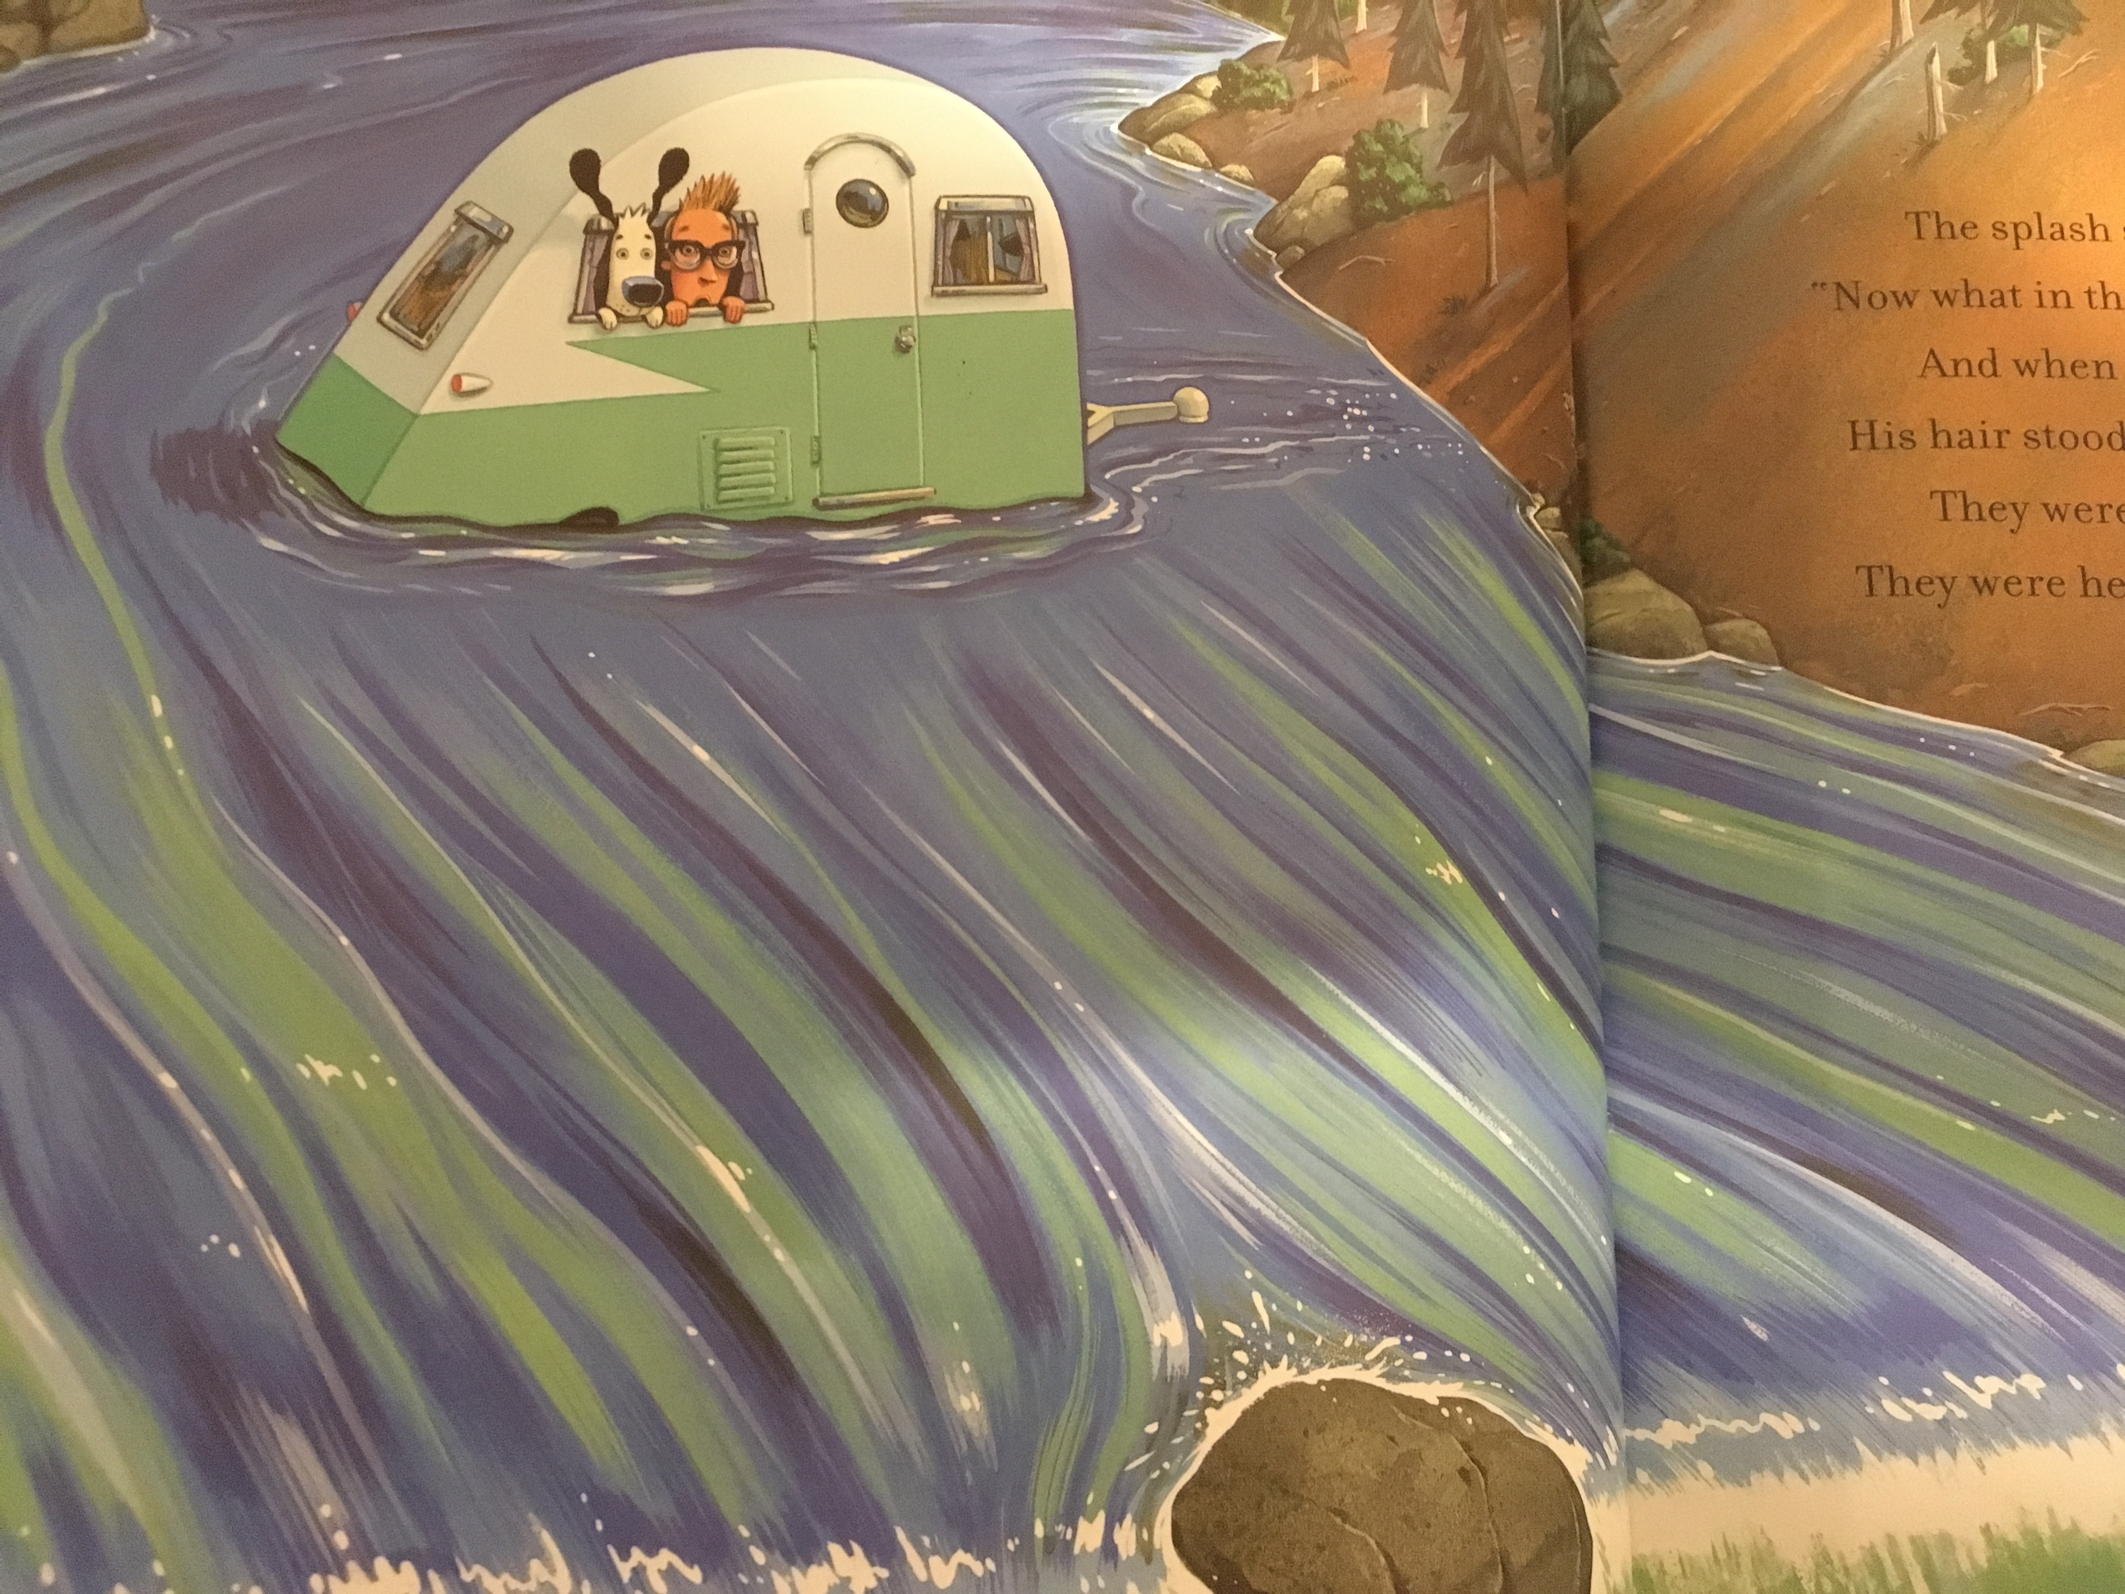
1. Push (water pushing camper downstream.)
2. Wedge, rock separates river pushing it into two streams.
3. Gravity (water falling off edge of waterfall.)
Taken from A Camping Spree With Mr. Magee by Chris Van Dusen.

Slide 6
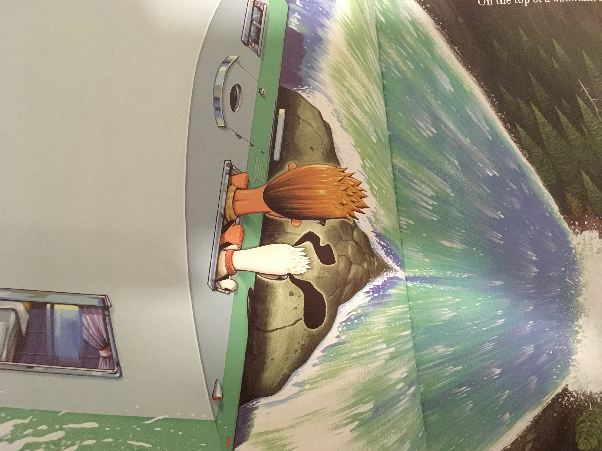
1. Push (water pushing camper).
2. Push (rock pushing camper.)
3. Gravity (pulling water towards earth.
Taken from A Camping Spree With Mr. Magee by Chris Van Dusen.

Slide 7
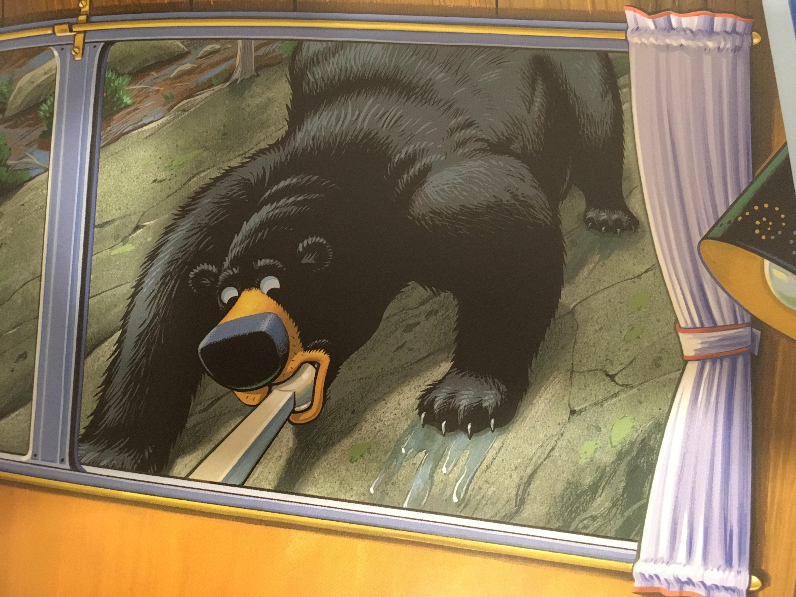
1. Pull (bear is pulling hitch.)
Taken from A Camping Spree With Mr. Magee by Chris Van Dusen.

Slide 8
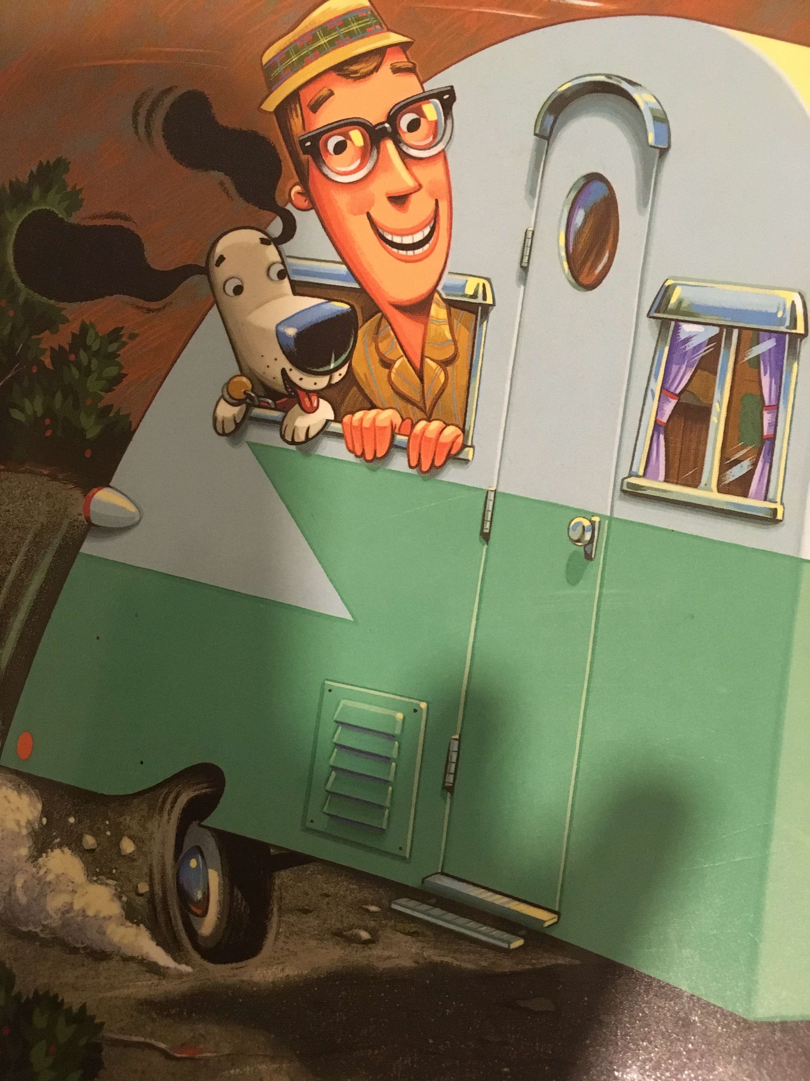
1. Wheels (on camper.)
2. Axle (on camper, not pictured.)
3. Hinge (holding door onto camper.)
4. Screw (inside door knob so that it will turn.)
5. Air pressure pushing Dee’s ears back.
Taken from A Camping Spree With Mr. Magee by Chris Van Dusen.

Slide 9
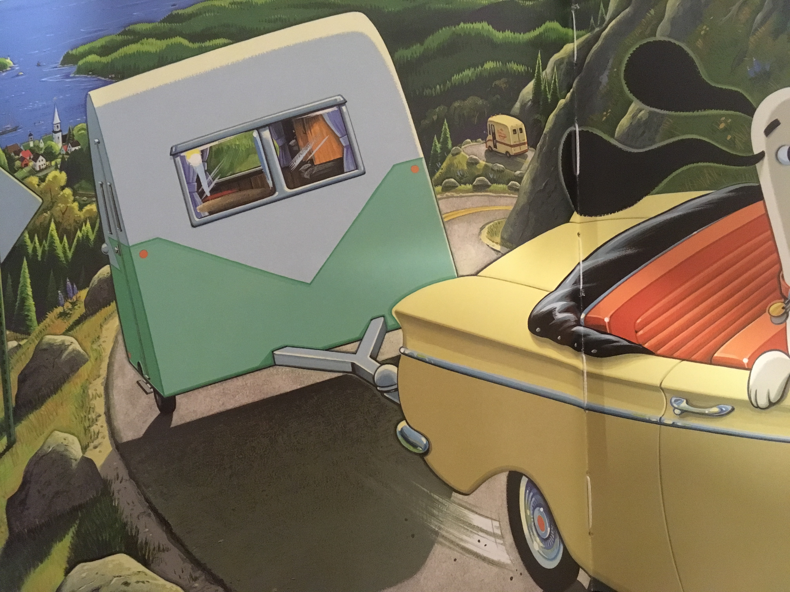
1. Pull (car pulling camper.)
2. Wheels (allowing car and camper to roll.)
3. Ramp or inclined plane (steep road.)
Taken from A Camping Spree With Mr. Magee by Chris Van Dusen.

